Slide 1

A DISTRIBUTION OF WEALTH – NEW YORK
Ana Tipple, Chenita Francis-Hare, Chioma Juliet Uche, Lishani Srikaran, and Rohan Ram
Notes:
Hello everyone, today we will be having a conversation about a distribution of wealth in New York. (10 seconds).

Slide 2
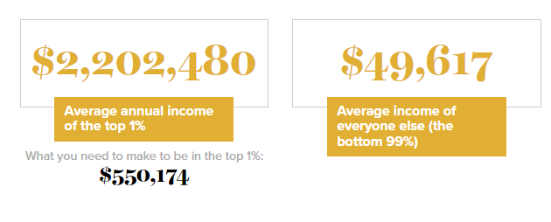
INTRODUCTION
(Economic Policy Institute 2023)
Notes:
- Within the US, New York State has some of the highest levels of income inequality.
- The top 1% make 44.4 times more than the bottom 99%, this is according to the Economic Policy Institute 2023.
(20secs)

Slide 3



“THEY SHOULD HAVE WORKED HARDER.”
(Save the Children 2023)
(Welcome to the Jungle 2021)
(Adobe Stock 2023)
Notes:
Within that 99%, there are some people who are really struggling day by day.
Some children grow up in poverty, they are hungry when they get to school which impacts concentration levels and must deal with more disruptive factors due to their household situation.
Full-time carers may have had to give up the dream of attending university meaning they are left with lower qualifications and less options.
- Or unfortunately, people are dismissed from opportunities due to their background, this can either be with intention or subconsciously.
(30secs)

Slide 4


CODING APPROACH
Notes:
Our visuals are displayed on an index webpage and update at the same time, the webpage was built and formatted using HTML/CSS. Although our HTML code references each script file used to generated the visuals, they are individually housed by programming languages inside a static folder for organisation purposes.

Slide 5

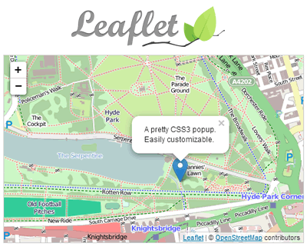
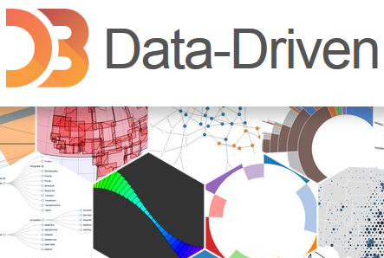
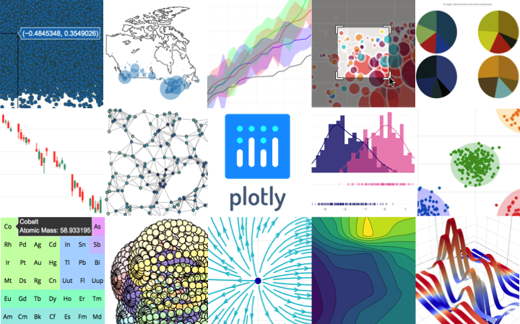
CODING APPROACH –
(Computer Hope 2023)
(Vegibit n.d.)
(Jquery Plugins 2013)
(Pypi 2023)
Notes:
The scripts to bring our visualisations to life were coded using JavaScript with the assistance of some libraries and plugins.
D3 allowed us to connect our cleaned data sources including 2 CSV’s and a geoJSON file.
Leaflet was used to create a map object with layers.
Plotly allowed us to create a user interactive scatter plot and heat map.
and a Leaflet plugin was adopted to incorporate a reset button on our first visualisation.
Some coding techniques included:
Using functions to optimise our code
For loops with conditionals enabled our dynamic visualisations,
and mapping was useful when obtaining values to plot from our CSV’s.

Slide 6
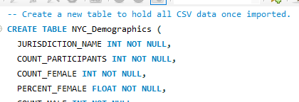
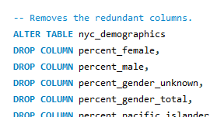
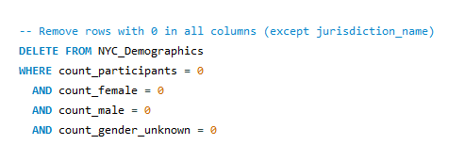
DATA WRANGLING TECHNIQUES
Anna
Notes:
- We used the US Government's Open Data web site to find useful reliable datasets that we could analysed. - We got a plethora of data sets. - And used SQL to clean and improve the quality of these data, - We found two data sets that could serve for the purpose of our project. - However, these raw data in the form of CSV files needed to be processed and cleaned before they could be used. - We created tables with columns that would support the content of these files. - The CSVs were then imported to those tables. - Redundant columns were then removed. - And rows that had no data in were also removed as they didn’t offer additional insight but noise. - Now over to Chenita

Slide 7
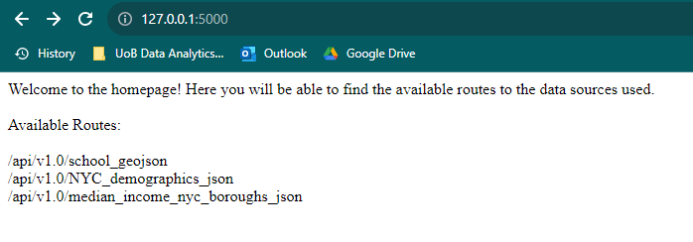
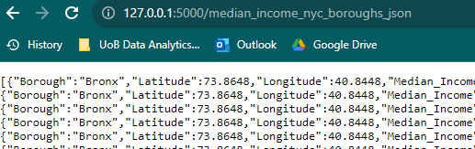
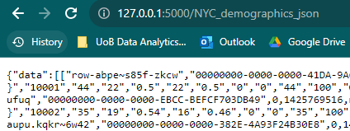
FLASK APP
Notes:
We created a flask application which allows a single point of access for external users to view each of the data sources used for this project.
The available routes are listed on the main page, and the user can view them by copy and pasting the relevant path extension to the url field. When a route is visited, that particular dataset populates within the current tab; and once the user is ready to view another file, they can simply select the back button and then copy and paste the dataset of their choice.
***Outro: Over to Uche... ***

Slide 8
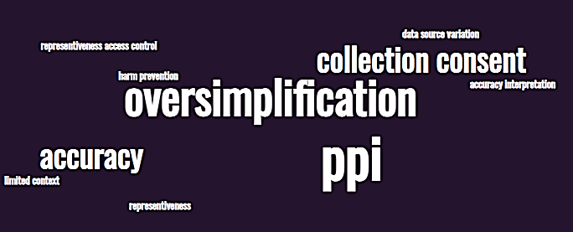
LIMITATIONS + ETHICAL CONSIDERATIONS
Uche
Notes:
The variability in community response affects the overall consistency of data which could result from lack resources in some communities, lack of coordination between communities or other factors that vary across the different jurisdictions.
Inconsistencies and inaccuracies of data source due to variations in reporting standards
The dataset available provides information for the fiscal year 2019 only, thereby limiting insights to that specific timeframe.
The dataset offers numerical data without extensive context, which may require additional information for comprehensive analysis.

Slide 9
REFERENCES
Arora, P. (2020, July 12). Minorities Around the World. Voices of Youth. https://www.voicesofyouth.org/blog/minorities-around-world
Child Hunger in America. (n.d.). Save the Children. https://www.savethechildren.org/us/charity-stories/child-hunger-in-america
Dante Lee International. (2019). 51% of American Students Are Considered Poor -- and Most Are From These 10 States! [Online image]. In Low Income Housing Authority. https://www.lowincome.org/2015/03/51-percent-american-students-poor-low-income.html
Detrick, B. (2013, June 26). Williamsburg’s Movie Houses: Where Popcorn Feels Passé. The New York Times. https://www.nytimes.com/2013/06/27/fashion/williamsburgs-movie-houses-where-popcorn-feels-passe.html
Diverse Group Serious Images – Browse 7,017 Stock Photos, Vectors, and Video. (n.d.). Adobe Stock. Retrieved August 14, 2023, from https://stock.adobe.com/search?k=diverse+group+serious
Gap between rich and poor, by state in the U.S. 2017 | Statistic. (2017). Statista; Statista. https://www.statista.com/statistics/227249/greatest-gap-between-rich-and-poor-by-us-state/
Interactive: The Unequal States of America. (n.d.). Economic Policy Institute. https://www.epi.org/multimedia/unequal-states-of-america/#/New%20York
Introduction To The D3 JavaScript Library. (n.d.). Retrieved August 14, 2023, from https://vegibit.com/introduction-to-the-d3-javascript-library/
Leaflet – JavaScript Library for Mobile Friendly Maps. (n.d.). JQuery Plugins. Retrieved August 14, 2023, from https://jquery-plugins.net/leaflet-javascript-library-for-mobile-friendly-maps
P, C. (n.d.). plotly: An open-source, interactive data visualization library for Python. PyPI. https://pypi.org/project/plotly/
The reality of quitting your job to become a full-time carer. (n.d.). Www.welcometothejungle.com. https://www.welcometothejungle.com/en/articles/the-reality-of-quitting-your-job-to-become-a-full-time-carer
‌What is JavaScript. (2019). What is JavaScript? Computerhope.com. https://www.computerhope.com/jargon/j/javascript.htm
‌
‌

Slide 10
DATA SOURCES USED FOR VISUALS
All data sources originated from government bodies.
Dataset 1 – (https://nces.ed.gov/programs/edge/economic/neighborhoodpoverty)
Household economic data from the Census Bureau’s American Community Survey (ACS) and public-school point locations developed by NCES to estimate the income-to-poverty ratio for neighbourhoods around school building.
Dataset 2 – https://catalog.data.gov/dataset/demographic-statistics-by-zip-code
Published by data.cityofnewyork.us which used information that is produced by the city’s government.
Dataset 3 – https://www.census.gov/quickfacts/fact/table/newyorkcitynewyork/HSG010222
United States Census Bureau (the official website of the United States Government)
‌
‌

